Slide 1
Extreme outside-in tdd with chadojs
an assume-verify-approach
Robin Danzinger

Slide 2
agenda
restaurant simulation
outside-in tdd
integration tests are scam
chadojs
discussion

Slide 3
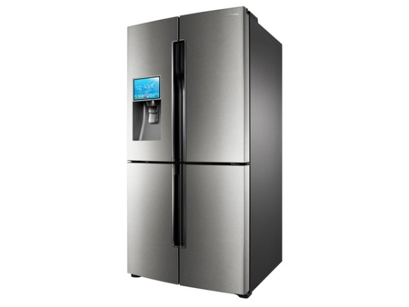

Restaurant simulation
I would like to have a pizza
I tell the chef to make a pizza
I fetch ingredients from the pantry and cook
Customer
Waiter
Chef
Pantry

Slide 4
Restaurant simulation
I would like to have a pizza
I tell the chef to make a pizza
I fetch ingredients from the pantry and cook
orders
passes order
gets
pizza
pizza
ingredients
Customer
Waiter
Chef
Pantry

Slide 5
Mit welchem Test beginnen?
Test
?
?
?
pass order
get
pizza
ingredients

Slide 6
Inside-out tdd
Test
Pantry
exercise
Test
Chef
uses
exercise
Test
Waiter
uses
exercise

Slide 7
Outside-in tdd
Test
Waiter
Test Double
exercise
Test
uses
Chef
Test Double
exercise
Test
uses
Pantry
exercise

Slide 8
Integration tests to the rescue
Test
Waiter
Test Double
exercise
Test
uses
Chef
Test Double
exercise
Test
uses
Pantry
exercise
Test
Waiter
Chef
Pantry
exercise

Slide 9
Integration tests to the rescue
Test
Waiter
Test Double
exercise
Test
uses
Chef
Test Double
exercise
Test
uses
Pantry
exercise
Test
Waiter
Chef
Pantry
exercise

Slide 10
Integration tests are a scam*
Unit
* J.B.Rainsberger
Programmfluss

Slide 11
Integration tests are a scam
Unit
Programmfluss

Slide 12
Integration tests are a scam
Unit
Programmfluss

Slide 13
Integration tests are a scam
2 * 2 * 2 *2 = 16 Möglichkeiten
Bei n Schichten und x Verzweigungen:
x^n Möglichkeiten

Slide 14
Integration tests are a scam
Unit
Programmfluss

Slide 15
Integration tests are a scam
Unit
Programmfluss

Slide 16
Integration tests are a scam
2 + 2 + 2 + 2 = 8 Möglichkeiten
Bei n Schichten und x Verzweigungen:
x * n Möglichkeiten

Slide 17
Wann sind Integrationstests weniger geeignet?
Basic correctness
Schnelle Laufzeit
Dokumentation des Codes
Einfache Testerstellung
Fehlerfindung

Slide 18
agenda
restaurant simulation
outside-in tdd
integration tests are scam
chadojs
discussion

Slide 19
Restaurant simulation
I would like to have a pizza
I tell the chef to make a pizza
I fetch ingredients from the pantry and cook
orders
passes order
gets
pizza
pizza
ingredients
Customer
Waiter
Chef
Pantry

Slide 20
Assume-Verify-Approach
Waiter
Testdouble
can order pizza
Assume
Chef can make pizza
Test
exercise
uses
Chef
Testdouble
Verify
Chef can make pizza
Assume
can take food
Test
exercise
uses

Slide 21
DEMO

Slide 22
agenda
restaurant simulation
outside-in tdd
integration tests are scam
chadojs
discussion

Slide 23
Vielen Dank!

Slide 24
Links
Chadojs on Github: https://github.com/robindanzinger/chadojs
J.B.Rainsberger: Integrated tests are a scam: http://blog.thecodewhisperer.com/blog/categories/integrated-tests-are-a-scam
bogus for ruby: https://github.com/psyho/bogus
midje for clojure: https://github.com/marick/Midje

